Slide 1
Computer Graphics rays and Quadrics
László Szécsi szecsi@iit.bme.hu
AIT

Slide 2
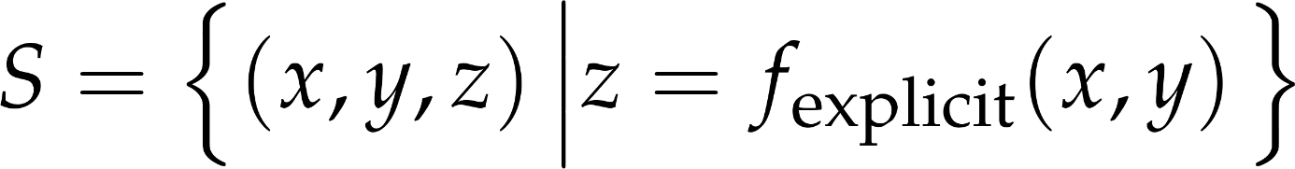
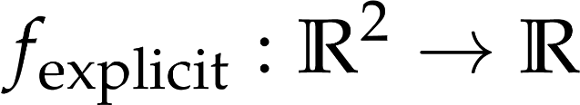

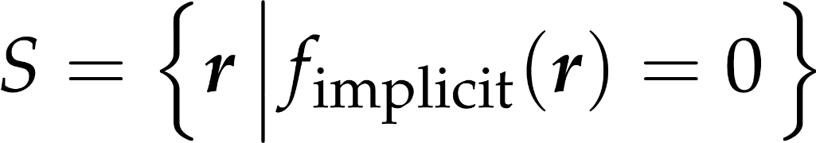
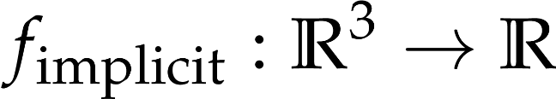
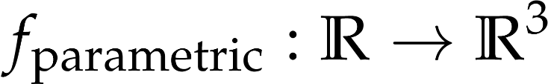
Surfaces as point sets
express one coordinate with the others
use a generic formula of
introduce new variables
Notes:
Surfaces are two dimensional subsets of the 3D space. Their deﬁnition is very similar to that of curves, but now the parametric equations have two free parameters (parametric equations of curves map a line segment onto the curve, parametric equations of a surfaces map a square onto the surface).

Slide 3
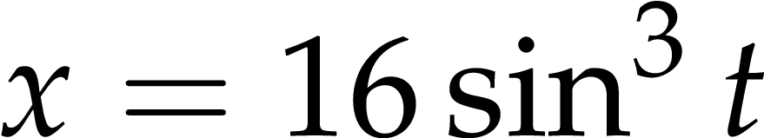
Do you recognize this?

Slide 4
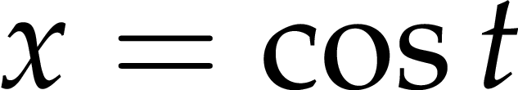
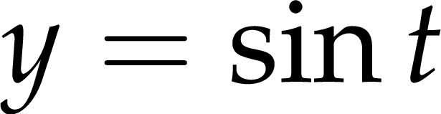
Do you recognize this?

Slide 5
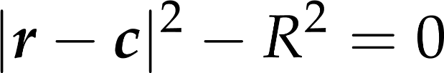
Implicit surface equations: sphere
scalar form:
vector form:
Notes:
What would the equation of a sphere be? Just like the circle in 2D, the sphere is defined as the set of points at distance R from center c. This condition can be written as an equation in both the more verbose scalar and the shorter vector notations.

Slide 6
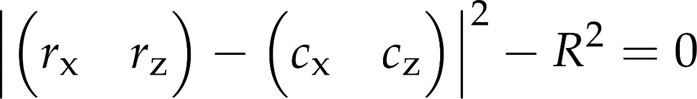
Implicit surface equations: inifinite cylinder, axis y
scalar form:
vector form:
Notes:
What about a cylinder? An infinite cylinder could be defined by a line for the axis and the radius R. To keep things simple, let us look at a special cylinder first: the one for with the axis direction is (0, 0, 1), and a point on the axis is c. What condition describes the x, y, z coordinates of surface points?
No condition for z, but x and y are on the circle around (cx, cy). The equation of this special cylinder is the same as the equation of the circle on the plane! This can be seen as extruding a circle from the plane by allowing all and any values for z.
Writing the vector form requires some thought. Of course, we write the 2D vectors from the elements of the 3D vectors, and use the vector form of the circle equation, but that does not accomplish a lot: we still have the subscripts, and we are not working with vectors and vector operations. Let us forget the special orientation cylinder, and work out the vector equation for the generic case: of course it will also cover the special case with axis=(0, 0, 1), but without any distinction for axis directions.

Slide 7
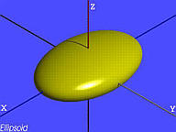
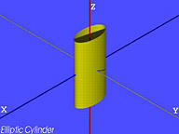
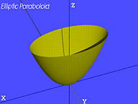
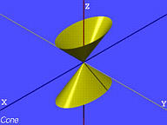
Implicit surface equations: quadrics
Notes:
A very important class of surfaces are those described by quadratic equaitions. They are called quadratic surfaces, or quadrics for short. They include spheres, ellipsoids, cones, cylinders, paraboloids, hyperboloids, and combinations thereof like the elliptic cylinder or the hyperbolic paraboloid.

Slide 8
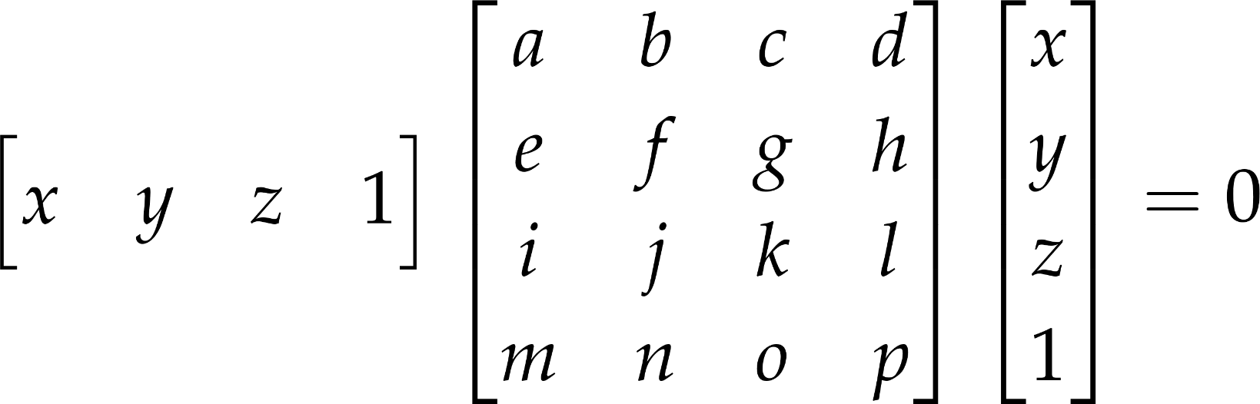
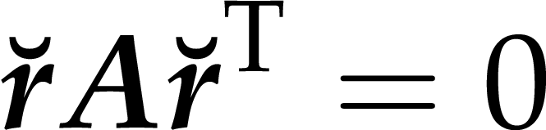
Implicit surface equations: quadrics
Notes:
That the implicit equation is quadratic means that the coordinate variables can appear at most twice as a factor in any of the terms making up the equation. There is no x*x*y or x*x*x. If we consider x*y and y*x different, this means 16 possible terms, thus 16 coefficients. Of course, x*y and y*x are not different, so we could do with 10 coefficients, but that would destroy the symmetry.
The 16 coefficients can be placed in a matrix, and the equation written with a vector-matrix-vector product. In both vectors, the free variables appear. Element a is the coefficient of the x*x term, b is the x*y term, d is the x term, p is the constant. Of course, the same surface can be represented by a lot of matrices, for example, if we decrease b and increase e with the same amount, the equation is equivalent.
Note that we had to extend the coordinate vector with a 1 to get four-element vectors, and thus accommodate the linear and constant terms in the matrix multiplication. These extended coordinates are a special case of homogeneous coordinates. The horns in the final, really compact equation indicate this extension to 4 elements.

Slide 9
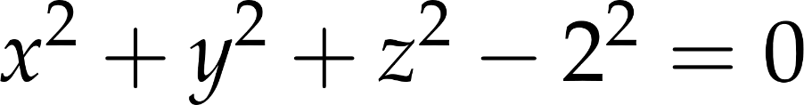
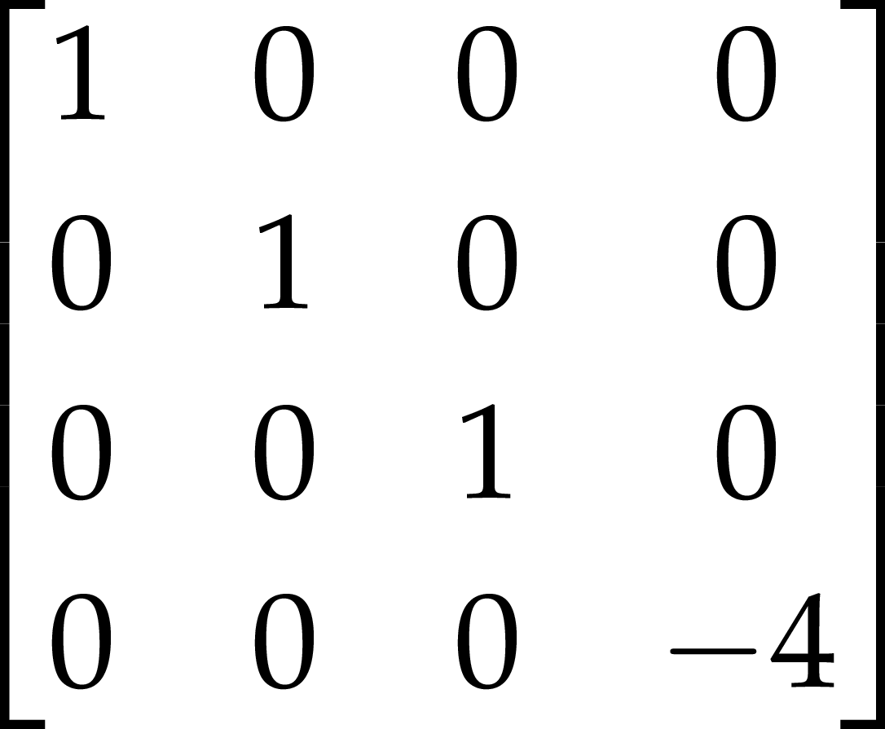
Quadric examples: origin-centered sphere of radius 2
Notes:
The sphere matrix is easy to construct by reading the coefficients from the sphere equation.

Slide 10
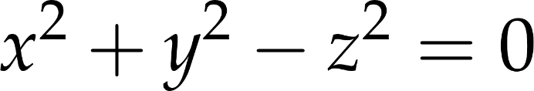
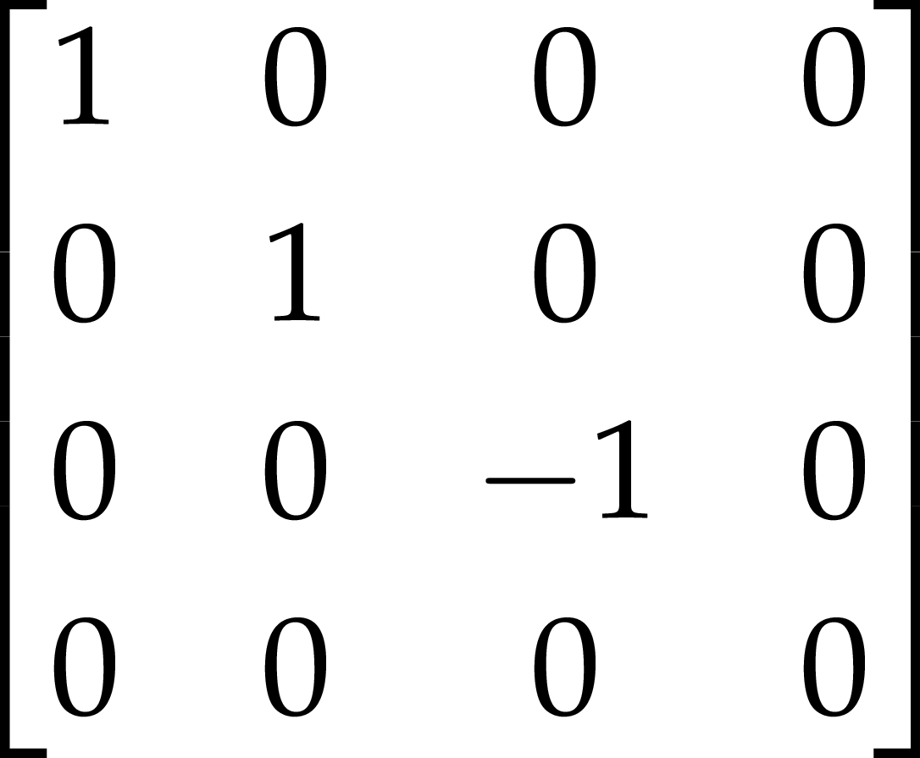
Quadric examples: 45° cone around z axis
Notes:
For the cone equation, consider the cross-sections at constant-z planes. The radius of the circle there is the z value. Thus, writing the circle equation with z as the radius does the job. The matrix only requires reading the coefficients from the equation.
These examples are to demonstrate that the coefficient matrix is a concrete matrix with concreate numbers, specifying the surface. For special surfaces like these, the matrix can be constructed manually. How to design more generic quadric shapes will be discussed later, when we already know about transformations.

Slide 11

3D rendering: The illusion of watching a 3D scene
Real world experience
Image on the display

Slide 12
Image synthesis by ray casting
screen
eye

Slide 13
Ray casting a single object
For all pixels:
find ray from camera through pixel,
find ray—object intersection (hit),
color pixel according to hit
draw full viewport quad, find rayDir using rayDirMatrix
in fragment shader (invoked for all pixels by the rasterizer)

Slide 14
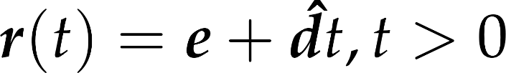
Ray
parametric halfline equation
primary rays
origin = eye
dir = ndcPos * rayDirMatrix
ray parameter
ray point
origin
direction
Notes:
Now we have calculated the ray direction for a pixel. The ray origin would of course be the eye position--- at least for primary rays.
In general, a ray is a halfline, with the above equation. t is the ray parameter. If dir is normalized (and it should be), then t is also the distance from the origin.

Slide 15
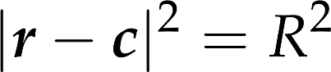

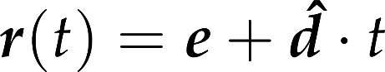
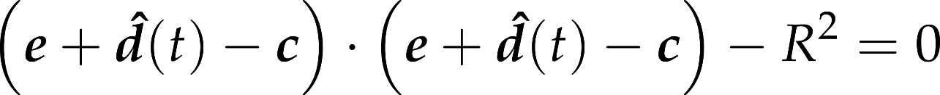
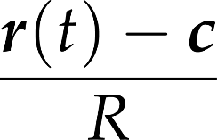
Intersection with a sphere
radius
center
no root 1 root 2 roots
wanted: smallest positive
surface normal:
Notes:
The implementation of method intersect depends on the actual type of the surface, since it means the inclusion of the ray equation into the equation of the surface. The first example is the sphere. Substituting the ray equation into the equation of the sphere and taking advantage of the distributivity of the scalar product, we can establish a second order equation for unknown ray parameter t. A second order equation may have zero, one or two real roots (complex roots have no physical meaning here), which corresponds to the cases when the ray does not intersect the sphere, the ray is tangent to the sphere, and when the ray intersects the sphere in two points, entering then leaning it. From the roots, we need the smallest positive one.
Recall that we also need the surface normal at the intersection point. For a sphere, the normal is parallel to the vector pointing from the center to the surface point. It can be normalized, i.e. turned to a unit vector, by dividing by its length, which equals to the radius of the sphere.

Slide 16
Quadratic surfaces - quadrics

Slide 17
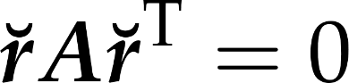
Implicit surface equations: quadrics
Notes:
That the implicit equation is quadratic means that the coordinate variables can appear at most twice as a factor in any of the terms making up the equation. There is no x*x*y or x*x*x. If we consider x*y and y*x different, this means 16 possible terms, thus 16 coefficients. Of course, x*y and y*x are not different, so we could do with 10 coefficients, but that would destroy the symmetry.
The 16 coefficient can be put in a matrix, and the equation written with a vector-matrix-vector product. In both vectors, the free variables appear. Element a is the coefficient of the x*x term, b is the x*y term, d is the x term, p is the constant. Of course, the same surface can be represented by a lot of matrices, for example, if we decrease b and increase e with the same amount, the equation is equivalent.
Note that we had to extend the coordinate vector with a 1 to get four-element vectors, and thus accommodate the linear and constant terms in the matrix multiplication. These extended coordinates will feature later extensively as a special case of the so-called homogeneous coordinates. The horns in the final, really compact equation indicate this extension to 4 elements.

Slide 18
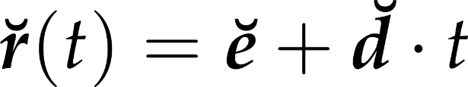
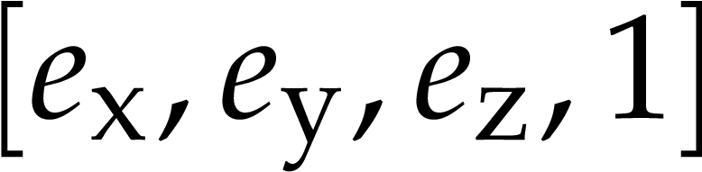
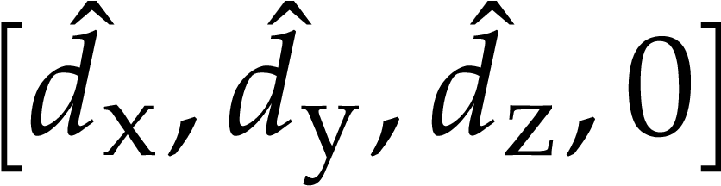
Ray equation with homogeneous coordinates

Slide 19
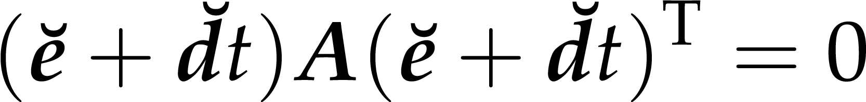
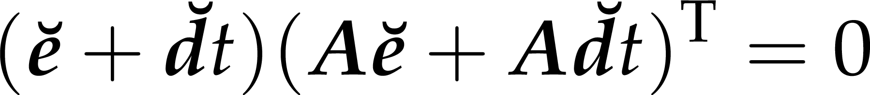
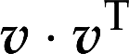
Ray-quadric intersection
dot(d * A, d)
quadratic equation for t
GLSL does not differentiate between row and column vectors
requires us to be explicit about the kind of multiplication we want
* does elementwise multiplication on two vectors, dot does

Slide 20
Concept
.
we do ray casting in the fragment shader, rendering a full-viewport quad
we already have the env map background
VS stays the same, computes rayDir
which is the ray direction indeed
FS intersects ray with surface
ray origin is the camera position
return background (environment) color if no intersection
return shaded surface color on intersection

Slide 21
Functions in GLSL
.
this is going to be much too complex for a single function
you can define GLSL functions
call them from main or from other functions
parameters can be marked in (default) or out (for additional outputs over the single return value)

Slide 22
Outline: ray—quadric intersection
.
function intersectQuadric
takes a coefficient matrix A,
ray origin e (homogeneous vec4),
ray direction d (homogeneous vec4).
Returns ray parameter t for smallest positive solution
or a negative value if no positive intersection was found

Slide 23
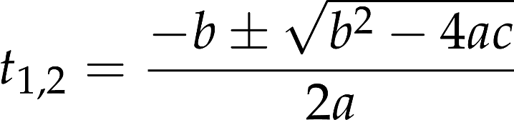
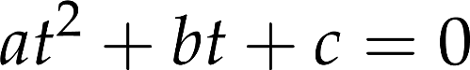
Solving the equation
.
compute quadratic coefficients a, b, and c
compute discriminant b*b-4*a*c
if negative, return t=-1 for no intersection
compute t1 and t2 as
(–b +- sqrt(discriminant)) / (2*a)
return lesser positive of t1 and t2
or either one, if both are negative
dot(d * A, d)
return (t1<0.0)?t2:((t2<0.0)?t1:min(t1, t2));

Slide 24
Outline: ray intersection in main
.
function main (the FS entry point)
compose vec4 e and vec4 d
call intersectQuadric
the coefficient matrix passed can be a constant
mat4 A = mat4( 1, 0, 0, 0,
0, 1, 0, 0,
0, 0, 1, 0,
0, 0, 0, -9 );

Slide 25
Outline: fragment color in main
.
depending on the return value of intersectQuadric
on no intersection (t<0), set fragment color to background color
on intersection (t>0)
set fragment color solid blue
alternatively: compute ray hit position and return it as color
accidentally, identical to the normal for an origin-centered sphere
vec4 hit = e + d * t;
fragmentColor.rgb = normalize(hit.xyz);

Slide 26
Expected result
!
a false-colored sphere before the environment background
remove any other game objects
or compose ray-cast and incrementally rendered scenes by giving quad fragments a depth
the mapping of fragment depth to hardware depth values is configurable via gl.depthRange(), and this happens to be the default
vec4 ndcHit = hit * camera.viewProjMatrix;
gl_FragDepth = ndcHit.z / ndcHit.w * 0.5 + 0.5;

Slide 27
Tasks
!
shading
use procedural solid texturing based on the hit position

Slide 28
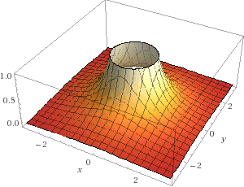
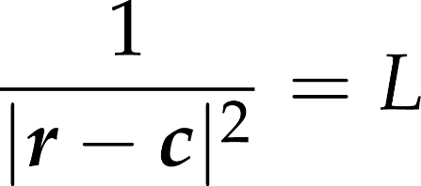
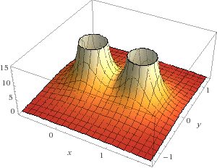
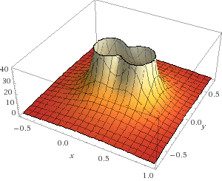
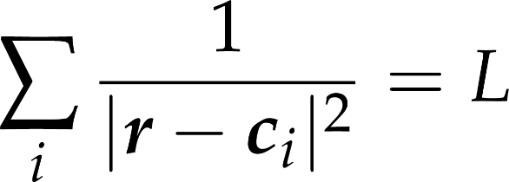
Metaballs
What equation is this?
What about a sum of these?
Notes:
Implicit surfaces can be more complex than quadrics. By summing simple inverse quadratic functions we get a smooth isosurface enclosing the centers.

Slide 29

Fun with metaballs

Slide 30
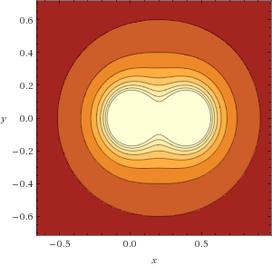
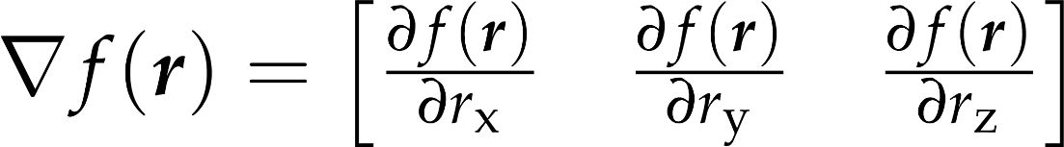
Surface normal of implicit surface

Slide 31
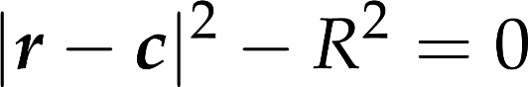
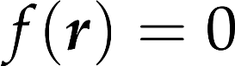
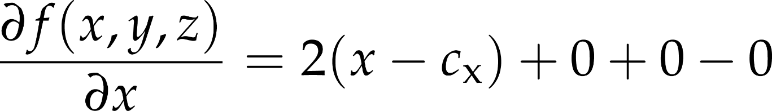
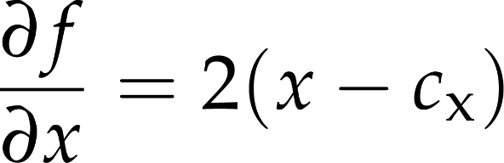
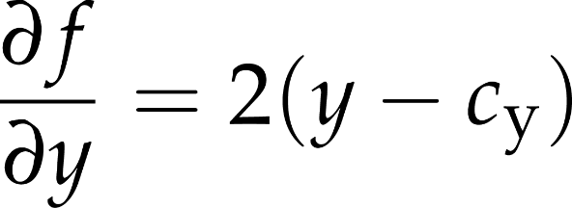
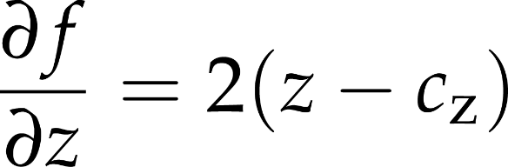
Sphere normal as gradient

Slide 32
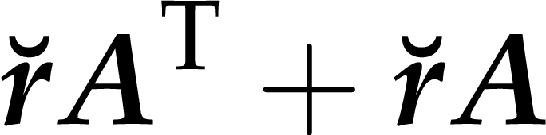
Quadric’s normal at surface point
first three elements of

Slide 33
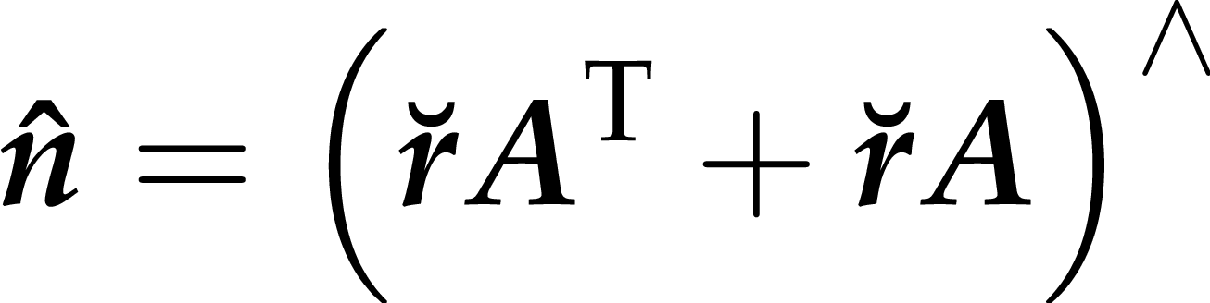
Finding the normal in main
!
if intersectQuadric returned t>0
compute intersection point
compute quadric normal at intersection point
set fragment color to normal, add actual shading later
vec4 hit = e + d * t;
vec3 normal = normalize( (hit * A + A * hit).xyz );

Slide 34
Task
!
experiment with different quadrics
edit coeff matrix elements
ellipse, cylinder, cone, paraboloid, planes

Slide 35
Clipped quadric
quadric A clipped to quadric B
do ray intersection for A
discard hits not in B
B
A

Slide 36
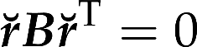

Clipped quadrics
.
function intersectQuadric replaced by intersectClippedQuadric
same code, but
also takes coeff matrix B as parameter
after t1 and t2 of ray—A intersection are found [which is existing code]
computes intersection points r1, r2, for t1, t2, respectively
evaluates left side of quadric equation with both r1 and r2
discards roots not in B ( )
continues with selecting the lesser positive of t1, t2 [which is existing coe]
mat4 B = mat4( 1, 0, 0, 0,
0, 0, 0, 0,
0, 0, 0, 0,
0, 0, 0, -4);
vec4 r1 = e+d*t1;
dot(r1*B, r1)
t1=-1.0;

Slide 37
Expected result
!
sphere clipped to slab: a ring
What does B *= -1 do?
What does switching the roles of A and B do?

